Slide 1




Bioinformatics project
Towards building a predictor for response to cancer treatment using tumor mutational signatures
Student: Stefano Pellegrini
Rigshospitalet supervisor: Maria Anna Misiakou
University supervisor: Albin Gustav Sandelin

Slide 2
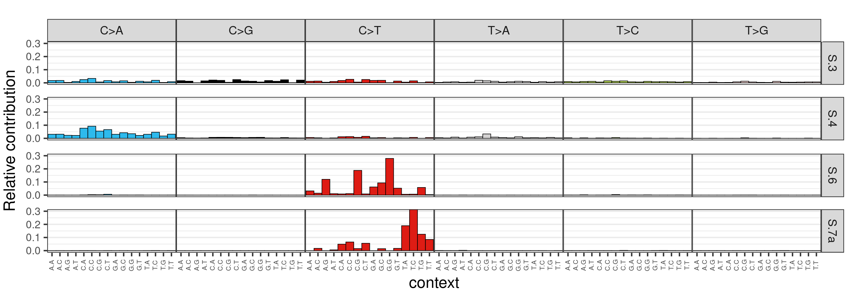
Mutational signatures
Characteristic combination of mutations in the human genome, 3 classes based on:
Single Base Substitution (SBS)
Double Base Substitution (DBS)
Small Insertion and Deletion (ID)
COSMIC reference signatures with proposed aetiology
Frequency of 6 SBS (C>A, C>G, C>T, T>A, T>C, T>G) in 16 trinucleotide contexts
Four COSMIC signatures
Proposed aetiology
HRD/BRCAnss
Tobacco smoking damage
MSI/MMR-D
UV light damage

Slide 3
Why mutational signatures?
Mutational signatures reflect the presence of mutational processes in cancer cells
Treatment
HRD due to BRCAness PARPi and platinum-based therapy
MSI due to MMR-D PD1 checkpoint inhibitors
Others
Diagnosis
UV light damage Melanoma cancer
Smoking damage Lung cancer
Others
Lack of functional pathways, such as DNA damage-response (DDR)
Presence of direct DNA damage
Others
Support to cancer diagnosis and treatment

Slide 4
Aim of the study
Use mutational signatures to stratify patients from Fase1 clinical trials according to characteristic profiles that may bear relevant clinical value
Ultimately, build a predictor for response to PARPi cancer treatment using mutational signatures and patients metadata

Slide 5
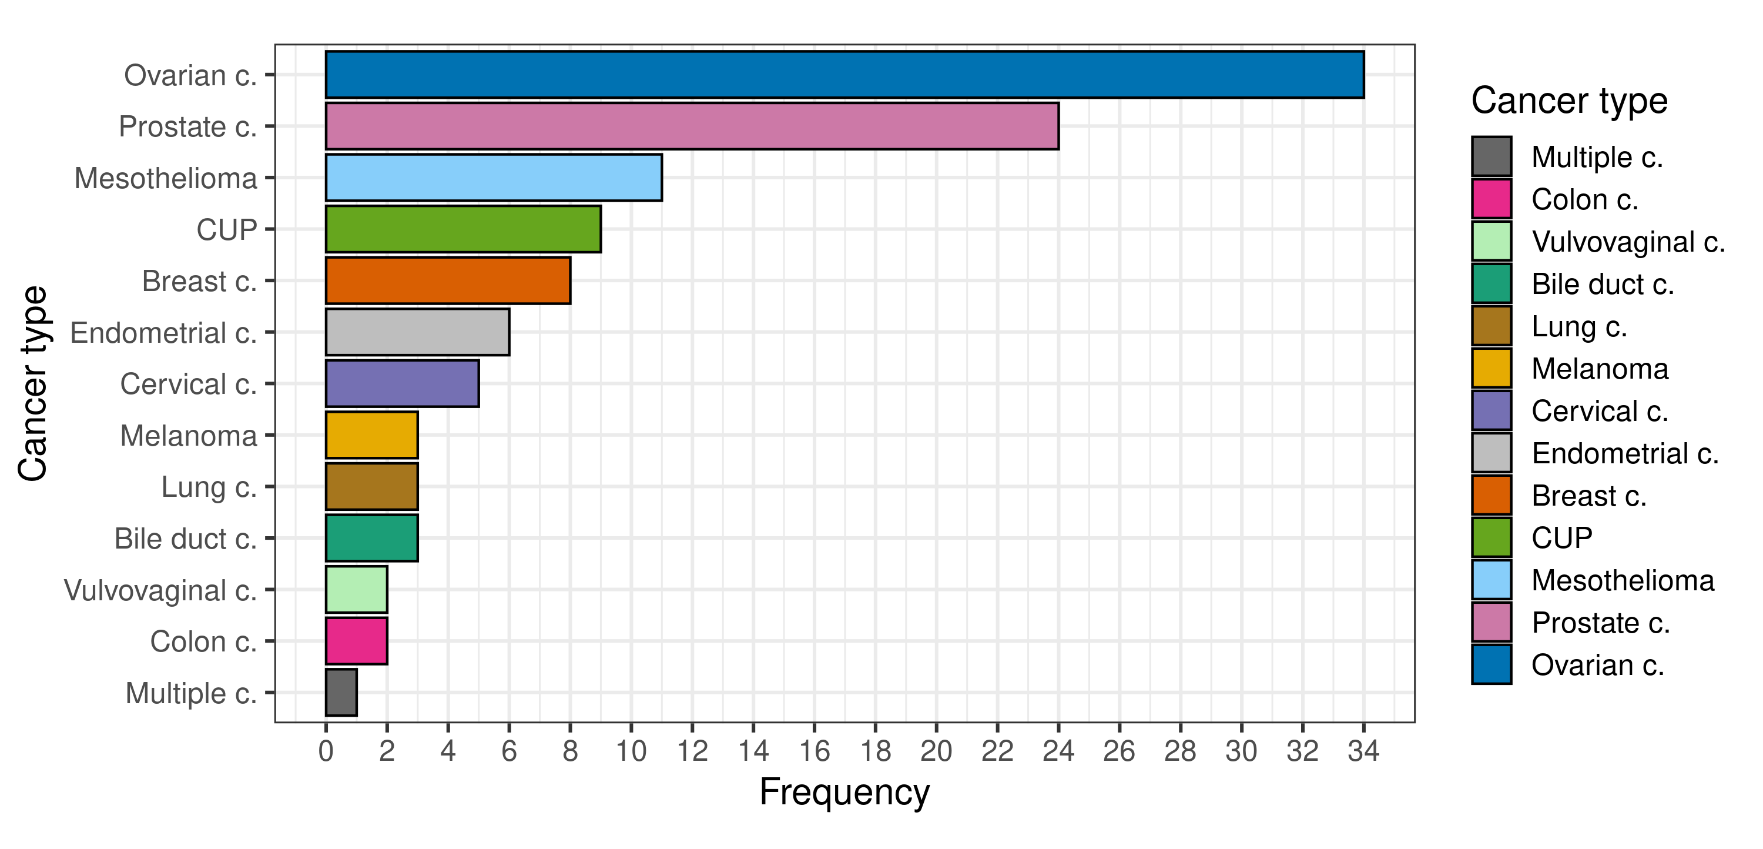
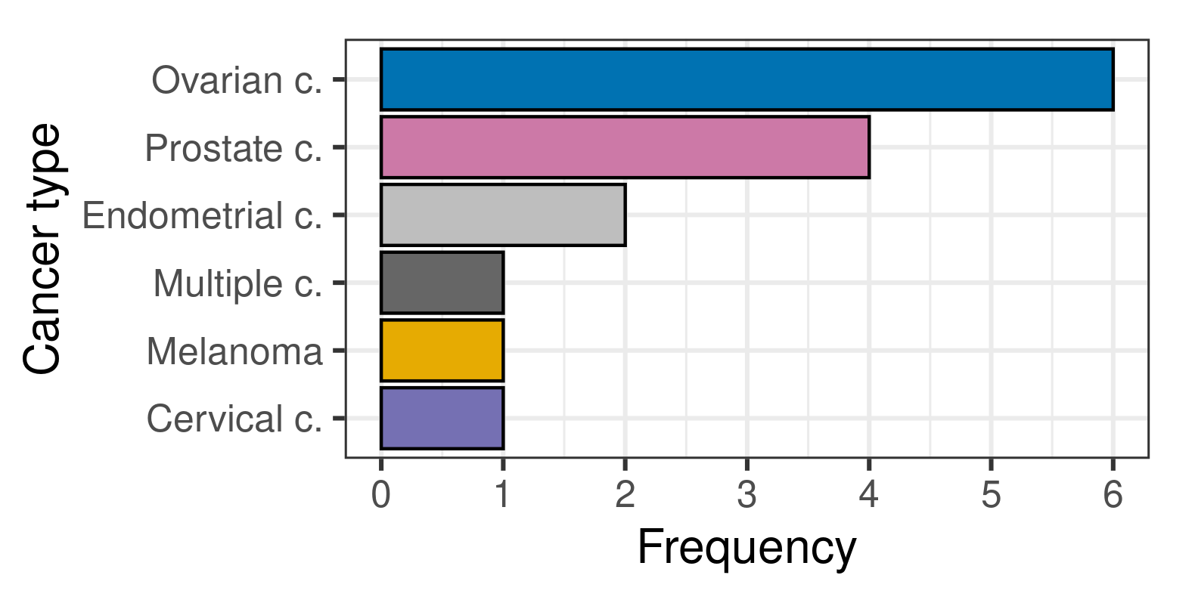
Data
VCF data from WES and metadata
Cohort of 111 samples from patients in Fase1 clinical trial
Mutational signatures analysis
Cohort subset of 15 samples from patients whose response to PARPi was available
Predictor building for PARPi response prediction

Slide 6
Methods overview
Samples mutational profiles
VCF data and metadata
Subset with available metadata on PARPi response
De novo signatures extraction and association to reference
Pairwise similarity of original mutational profiles VS reference
Profile reconstruction by fitting to extracted signatures
Data preprocessing
Cosine similarity matrix
Relative contribution matrix
Logistic regression
Random forest
Patients stratification on genomic profiles
(data mining)
Treatment response prediction (LOO-CV) and model evaluation

Slide 7
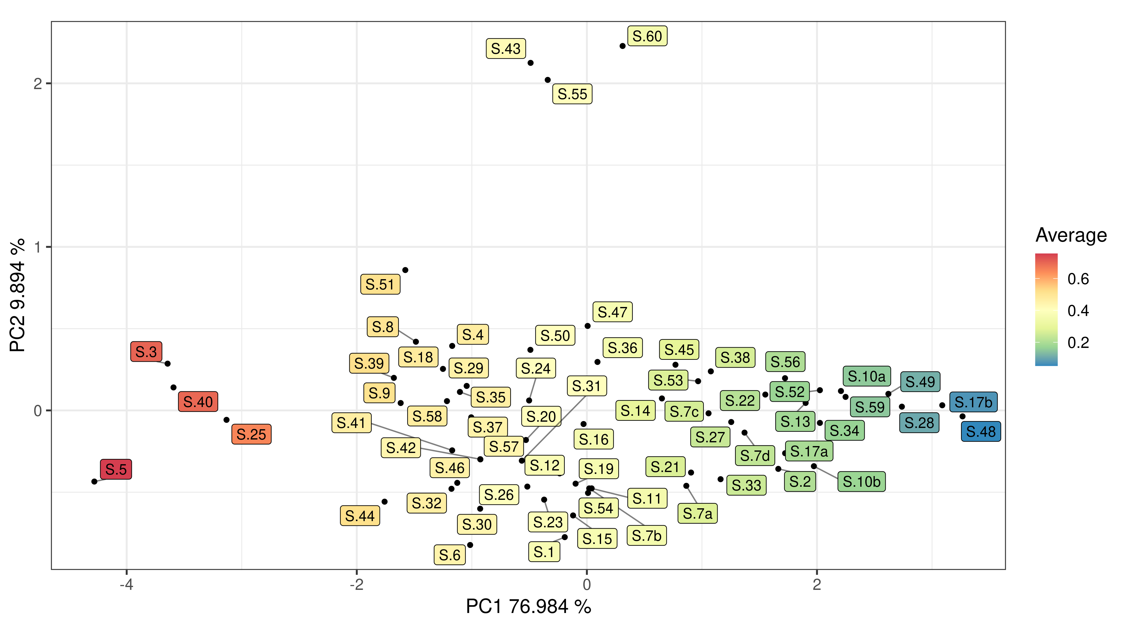
Data mining
Mutational pattern associated with sequencing artefact
PCA pairwise similarity signatures as input
HRD/BRCAness
Prior chemotherapy
Spontaneous deamination due to aging

Slide 8
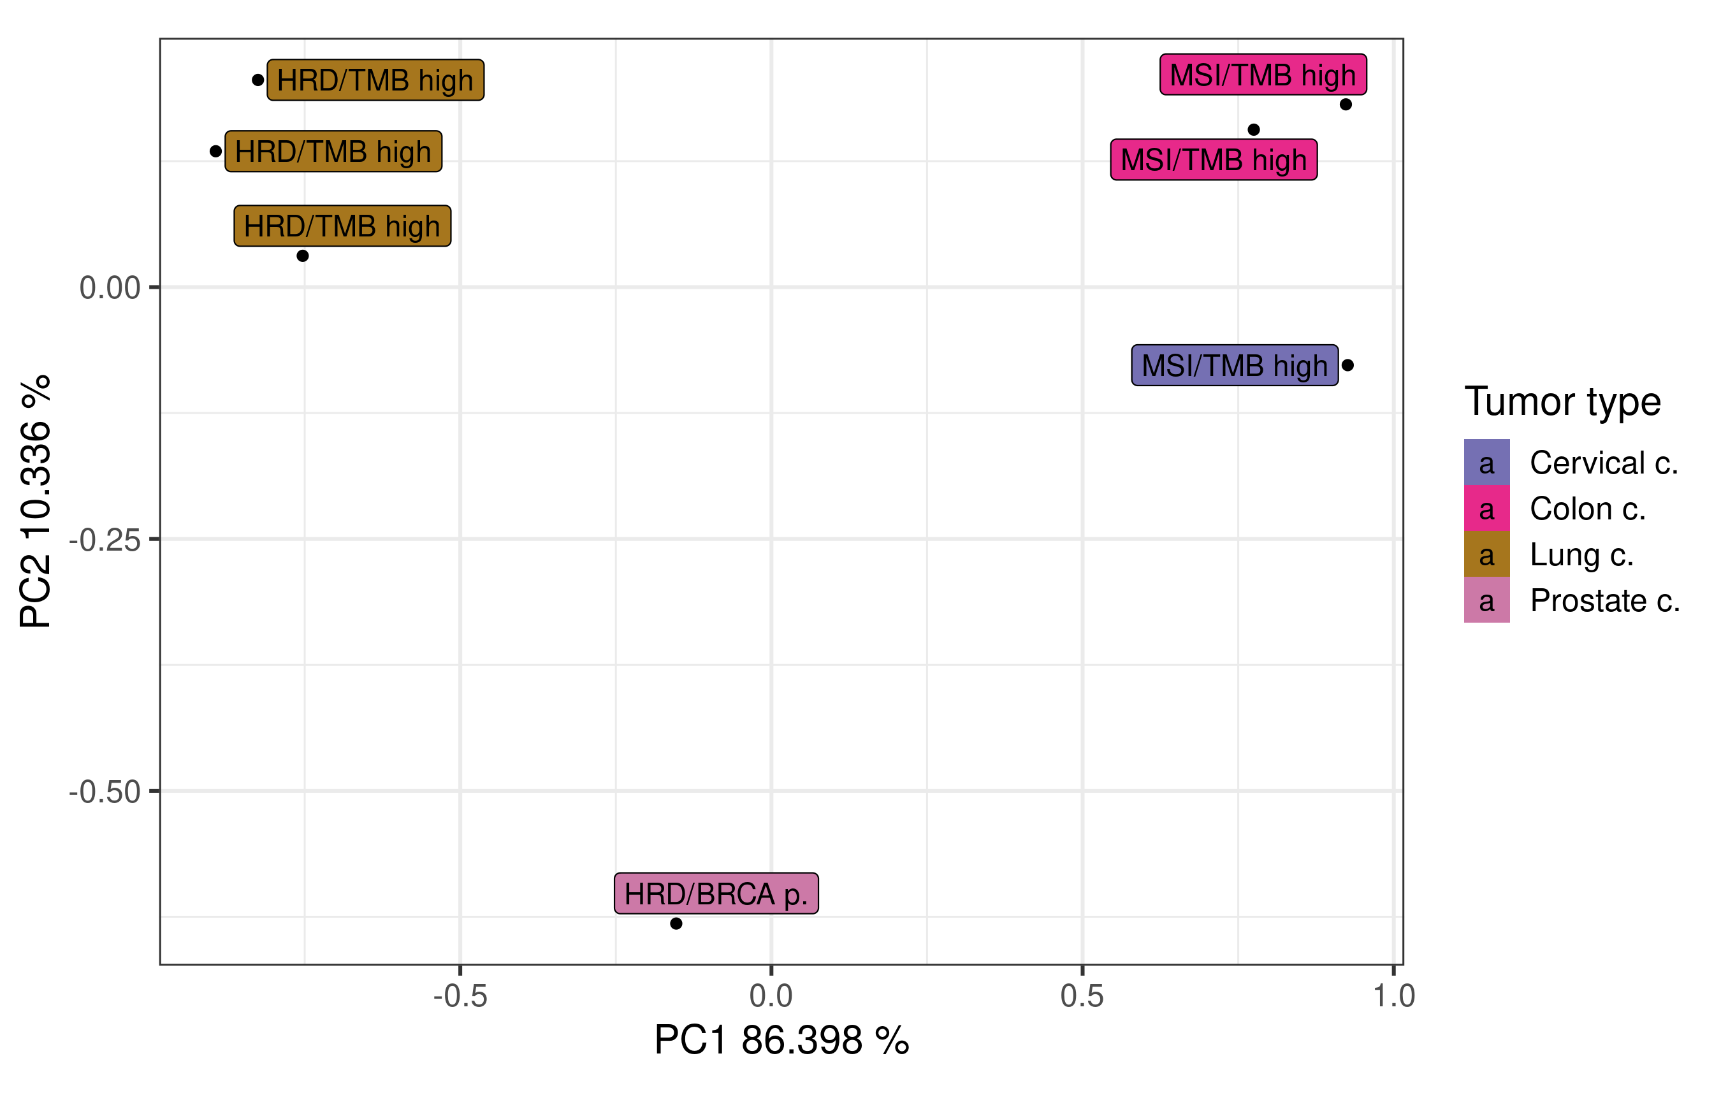
Data mining
PCA pairwise similarity samples with verified annotations
3 clusters corresponding to the annotation and cancer types
We will see that each annotation is correctly detected

Slide 9
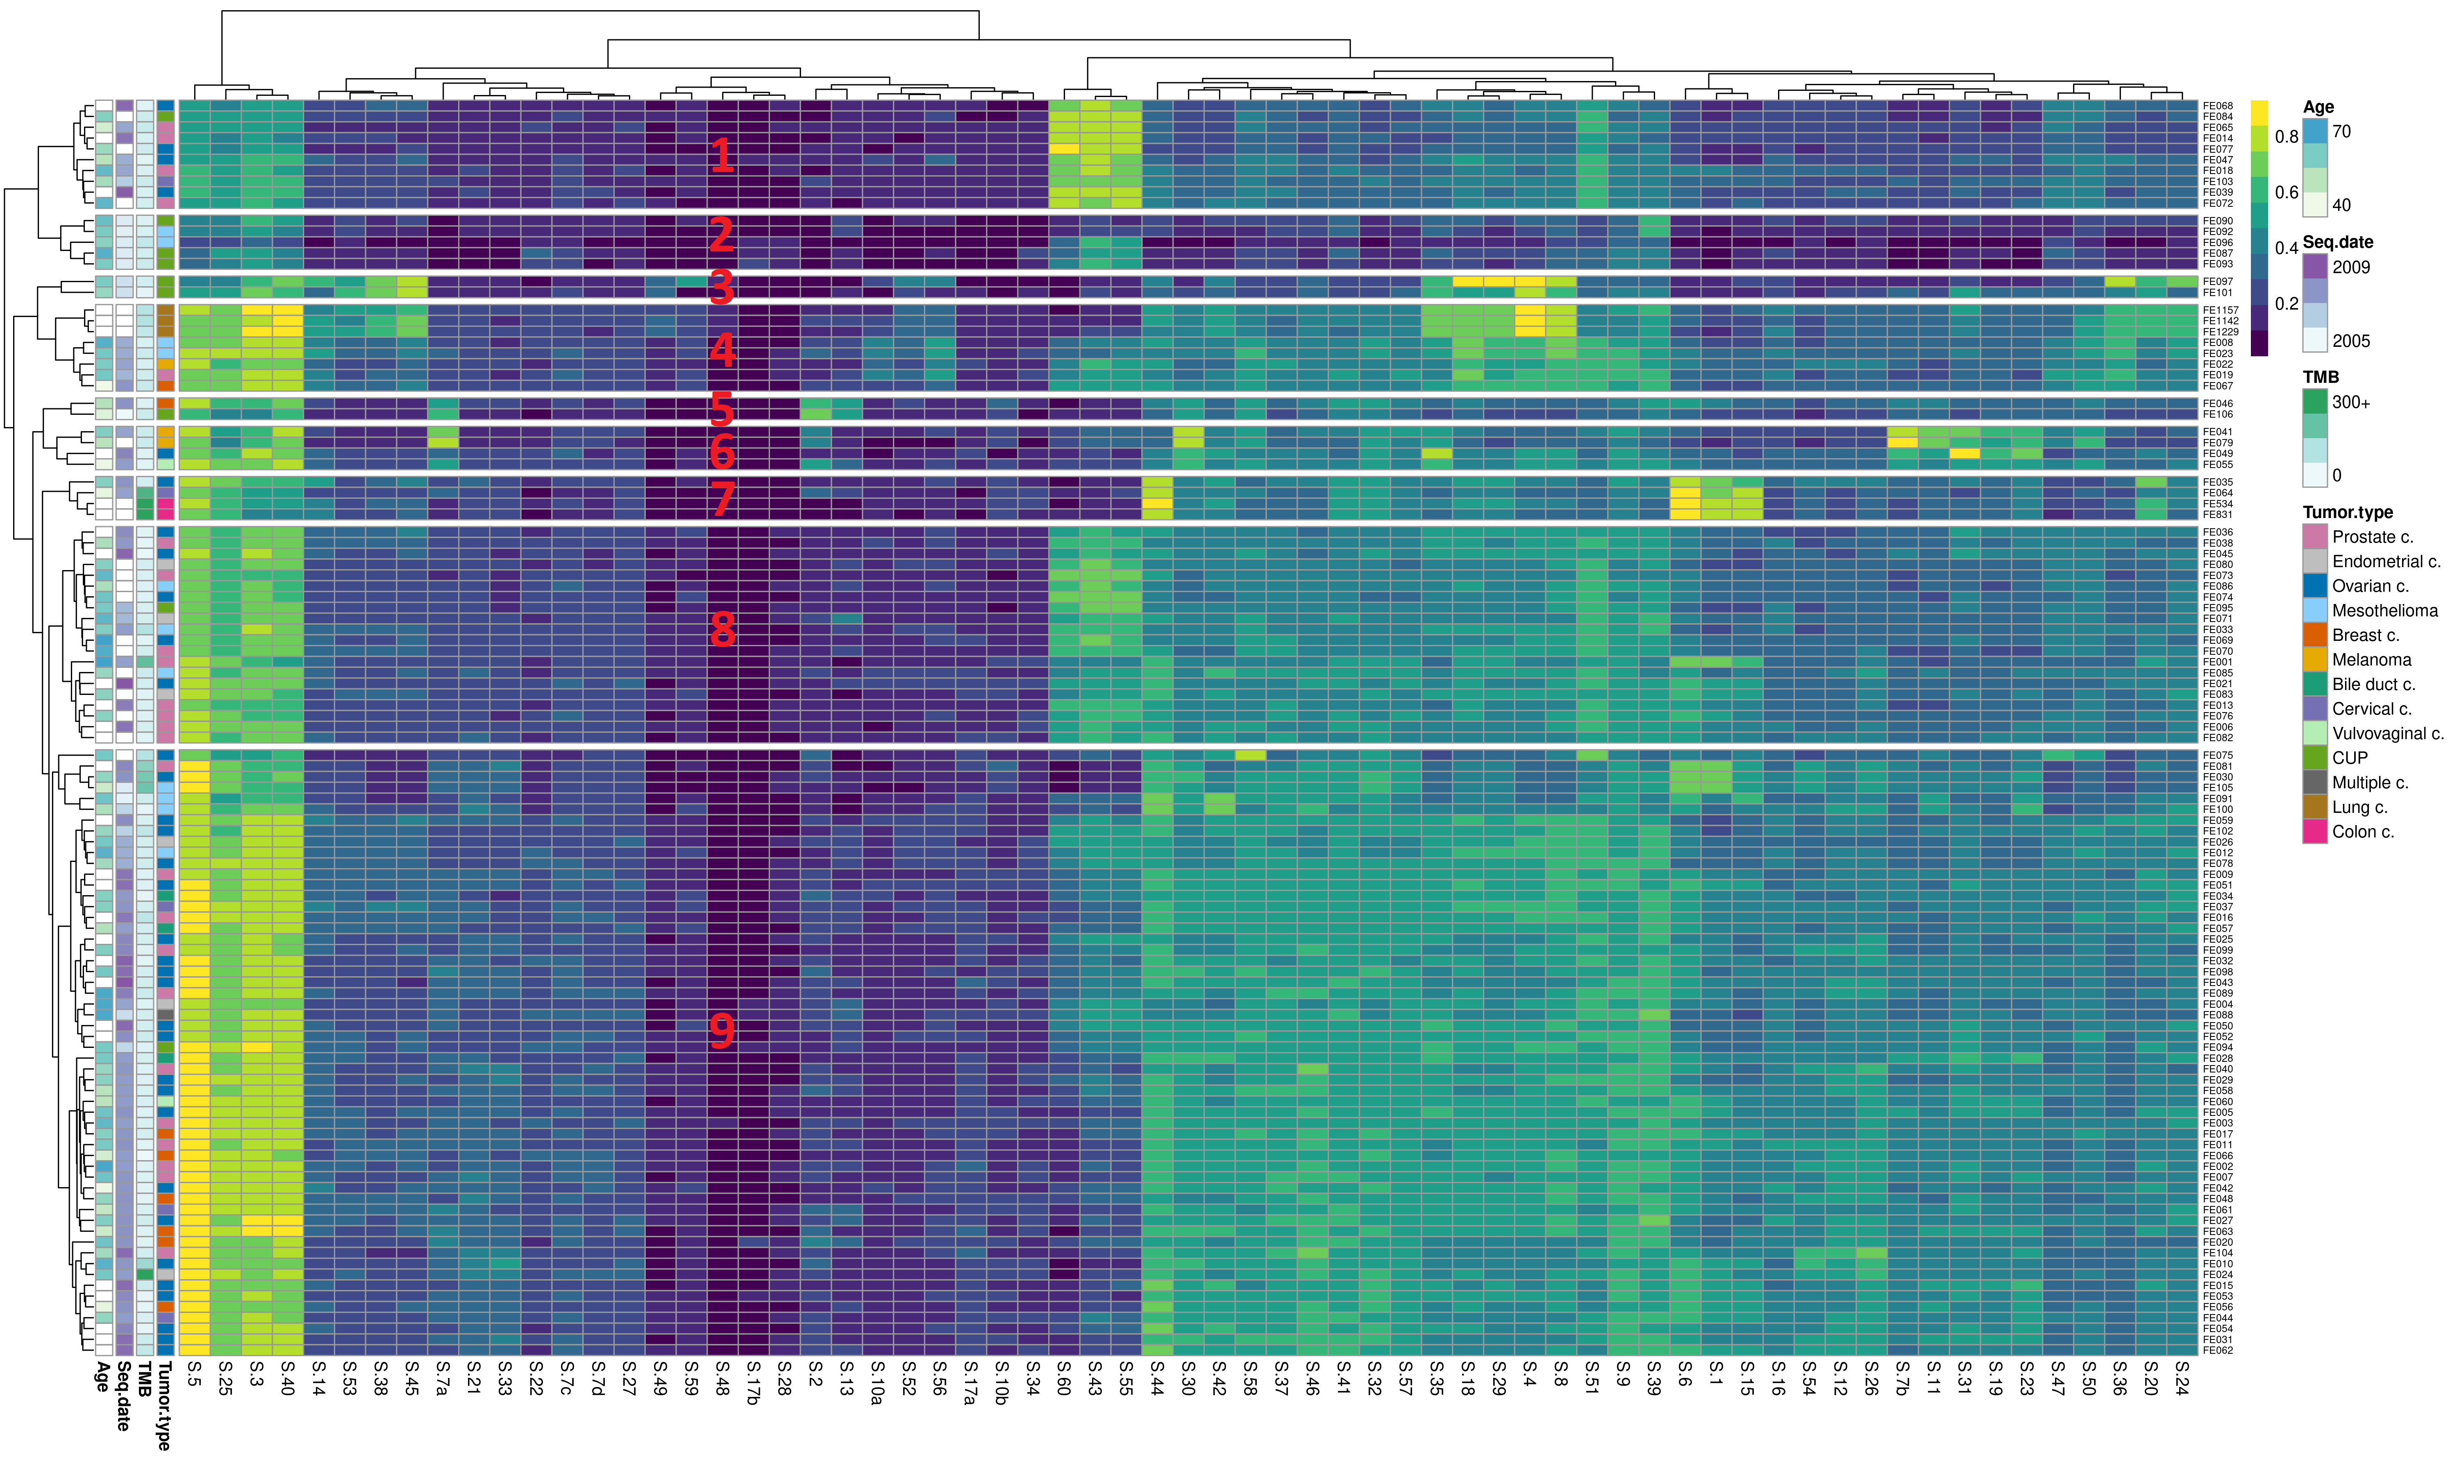
Data mining
Heatmap pairwise similarity
Verified HRD
Technical bias
HRD/Smoker
AID/APOBEC
UV damage
MSI profile
Technical bias weak clock/HRD
Verified MSI
Clock/HRD
Verified HRD

Slide 10
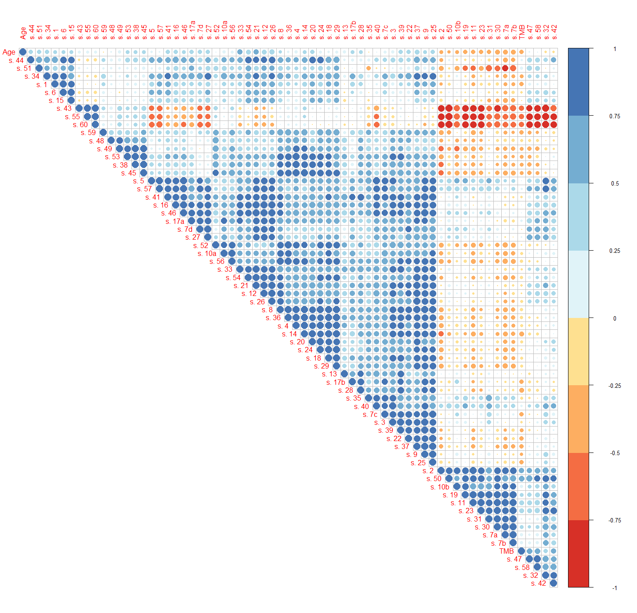
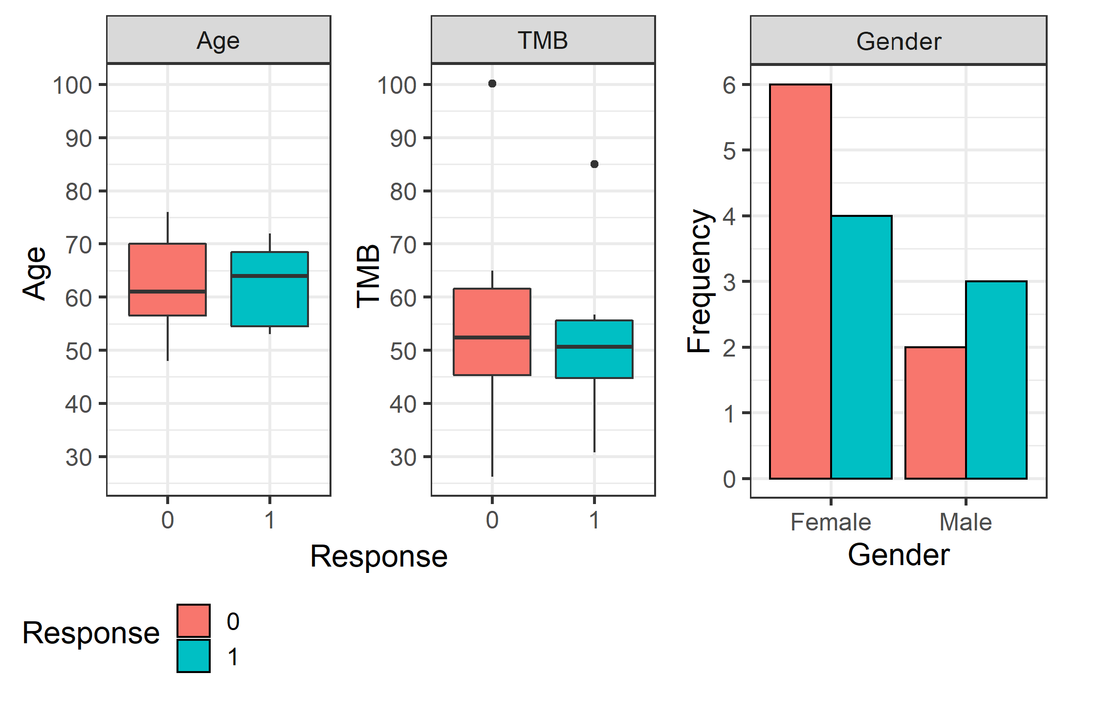
Model building
Correlation matrix
Predictor variables exploration
Metadata
Multicollinearity
The models parameters can’t be interpreted

Slide 11
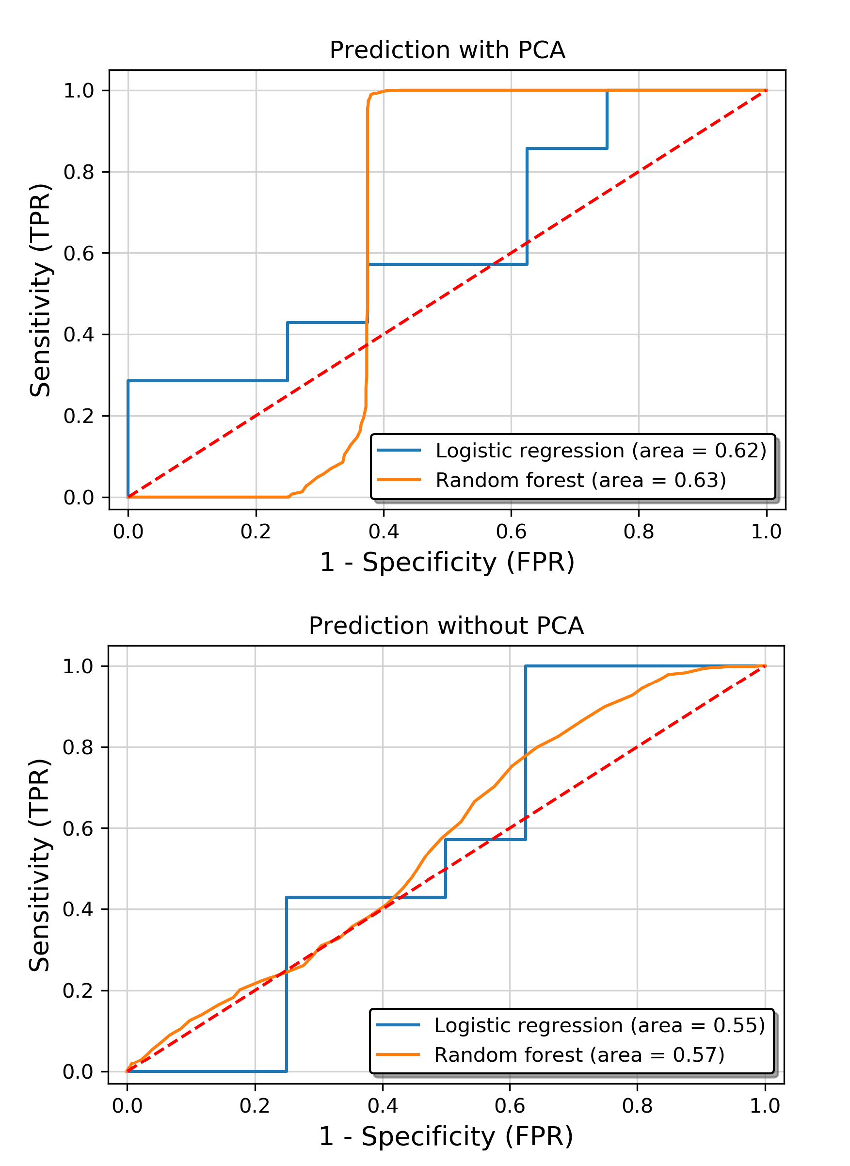
Model evaluation
ROC curves on LOO-CV predictions:
Bias was introduced during preprocessing (test set is not real unseen data)
Even if performance is overestimated, the models have poor generalization performance
Models weakness:
Limited sample size bottle neck
Lack of validation and test datasets
Lack of features selection and
hyperparamer optimization
Limited learning ability

Slide 12
Summary
We succeed to stratified the Fase1 clinical trial samples according to endogenous and exogenous cellular processes
The model we built for the prediction of PARPi cancer treatment response did not achieve good generalization performance, but we identified its main weakness in the limited size of the cohort
Potential support to
Cancer diagnosis
Cancer treatment selection
Decision making in cancer care
The study can be repeated when more data is available

Slide 13

Thanks for your attention

Slide 14
Supplementary materials

Slide 15
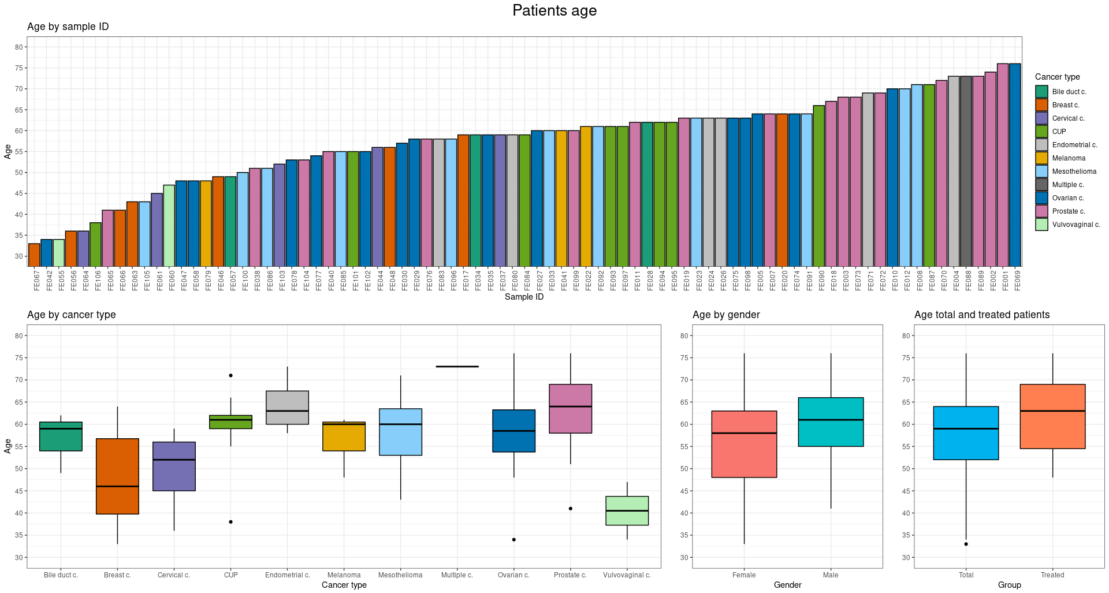

Slide 16
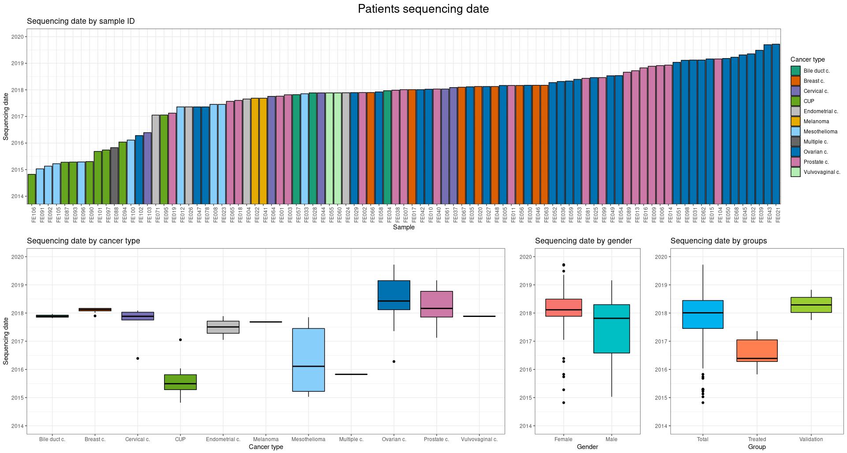

Slide 17
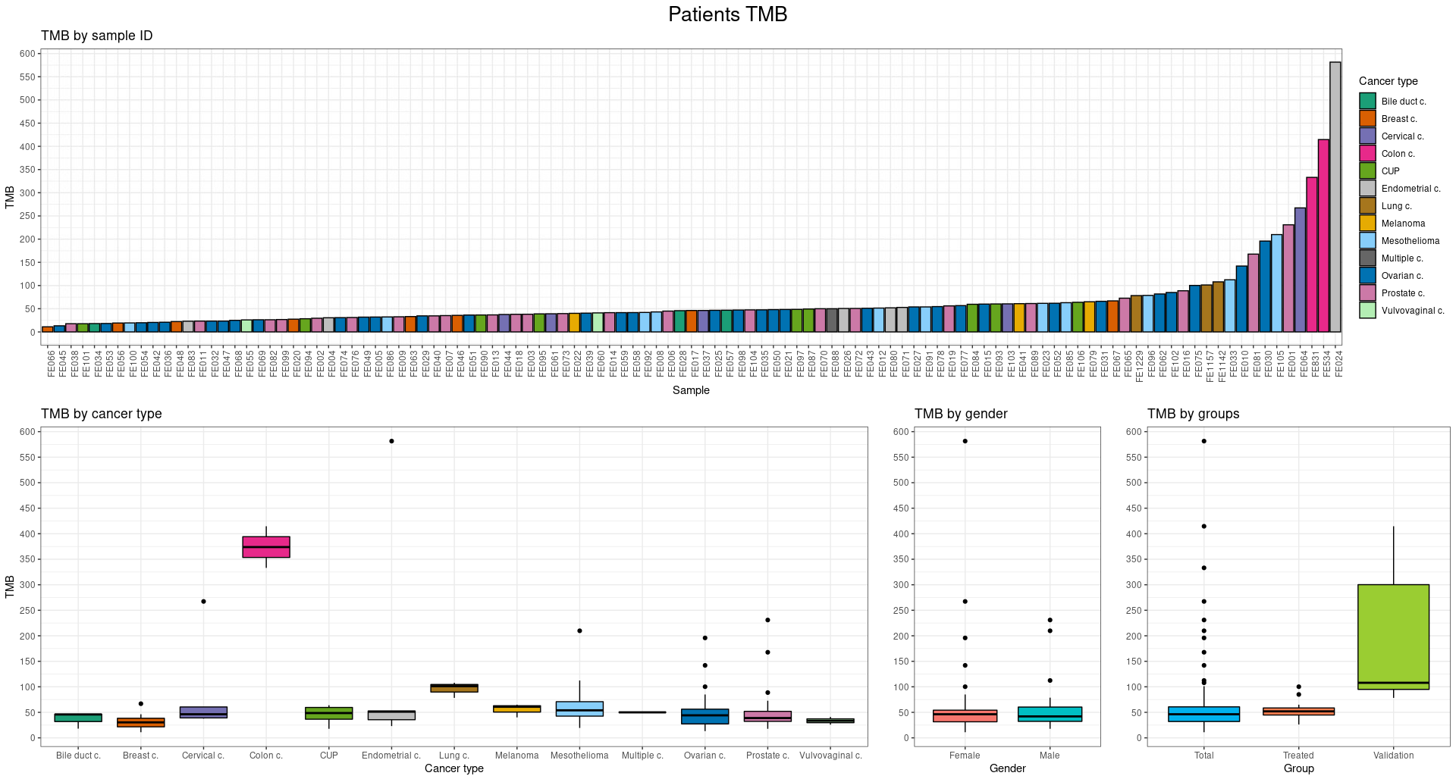

Slide 18
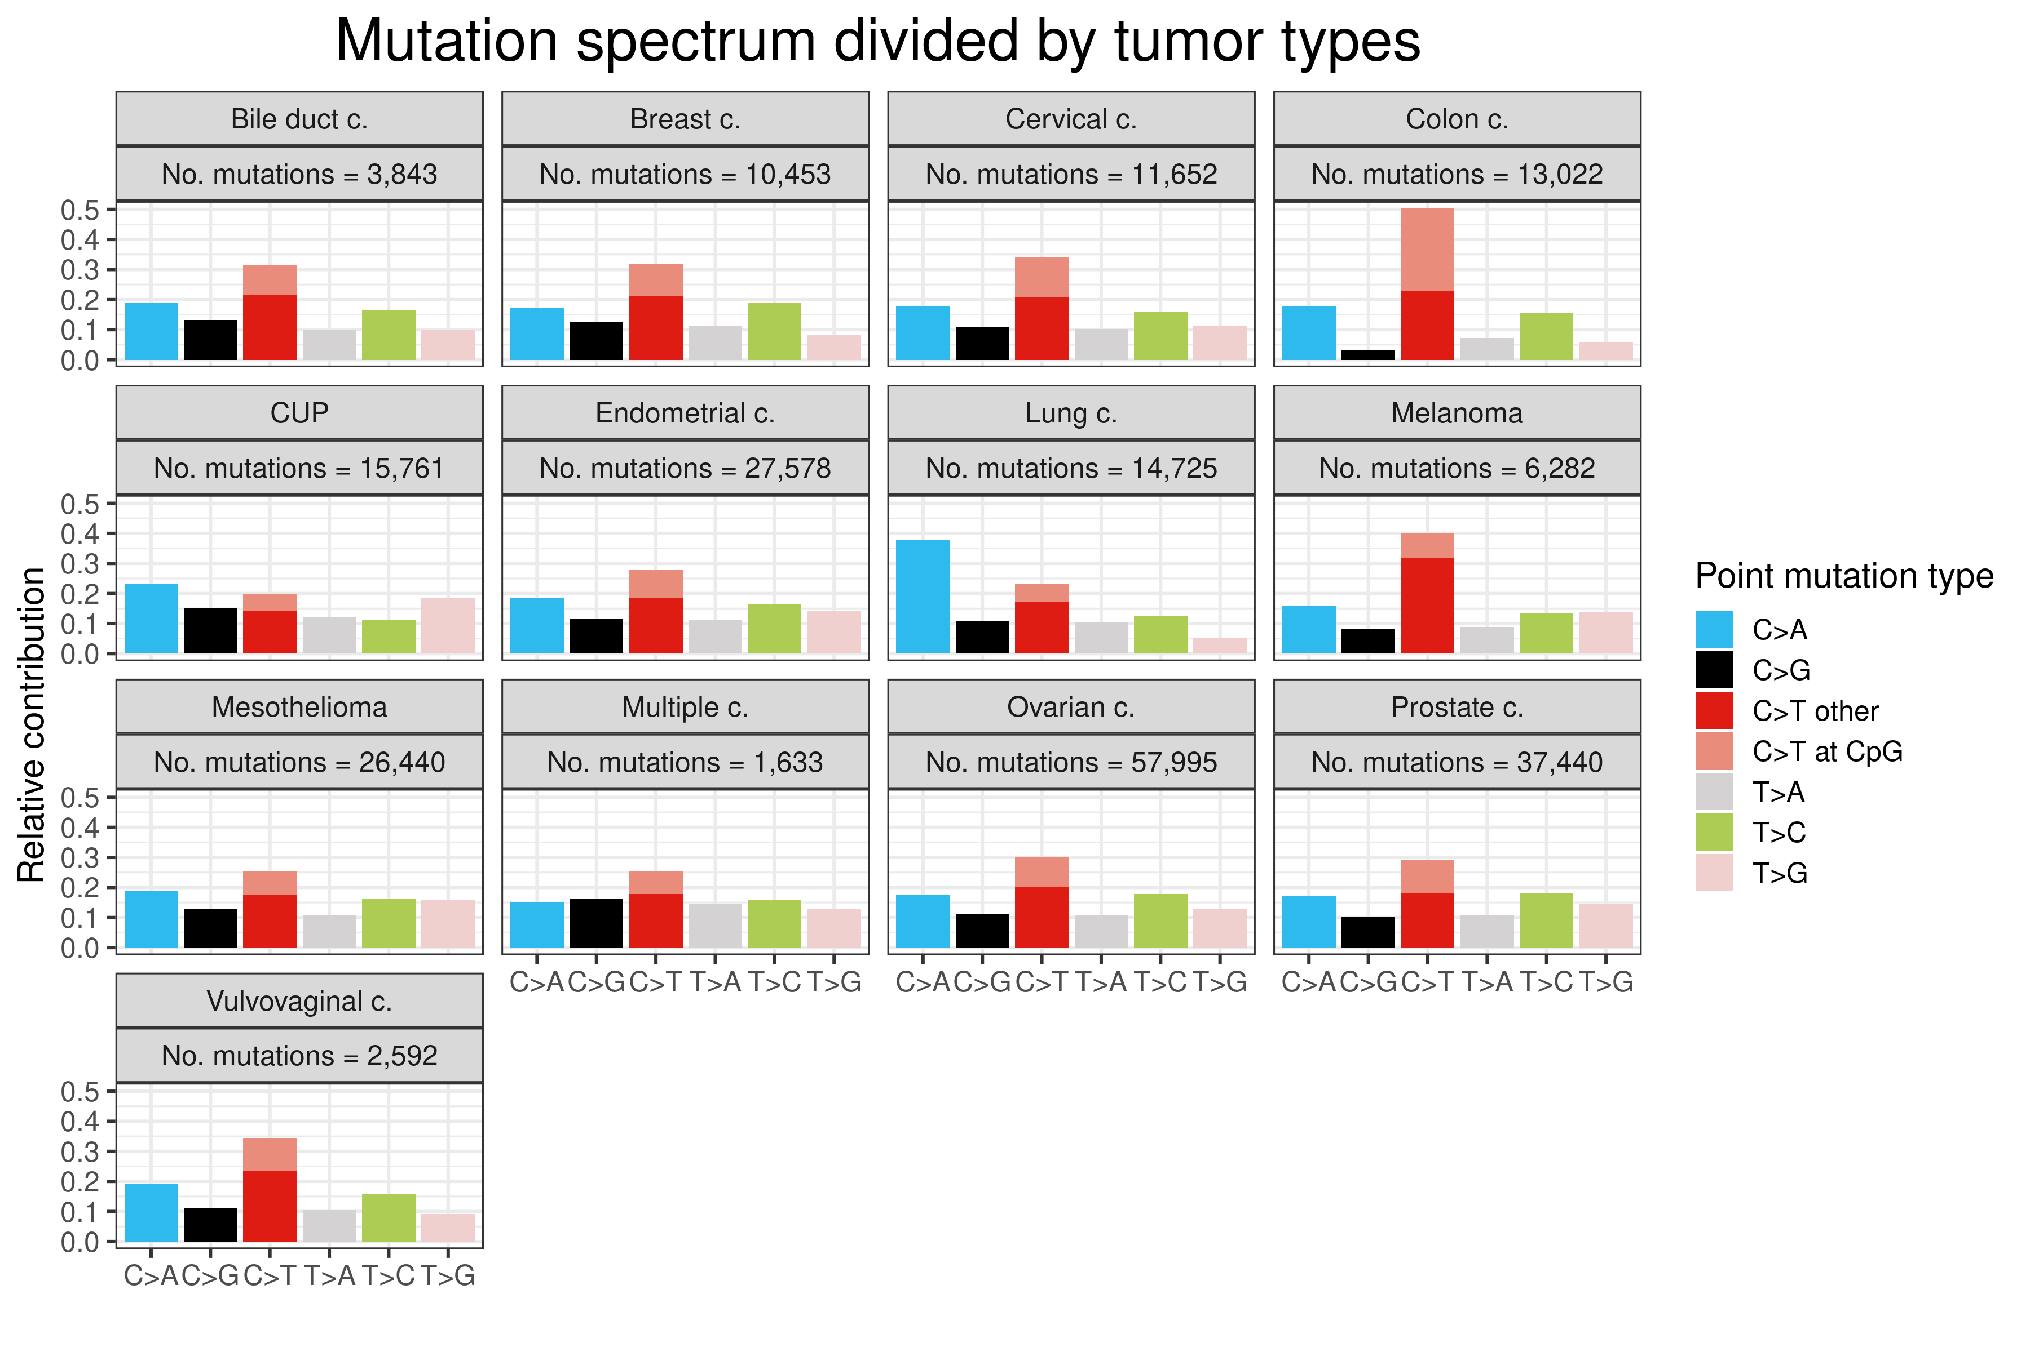

Slide 19
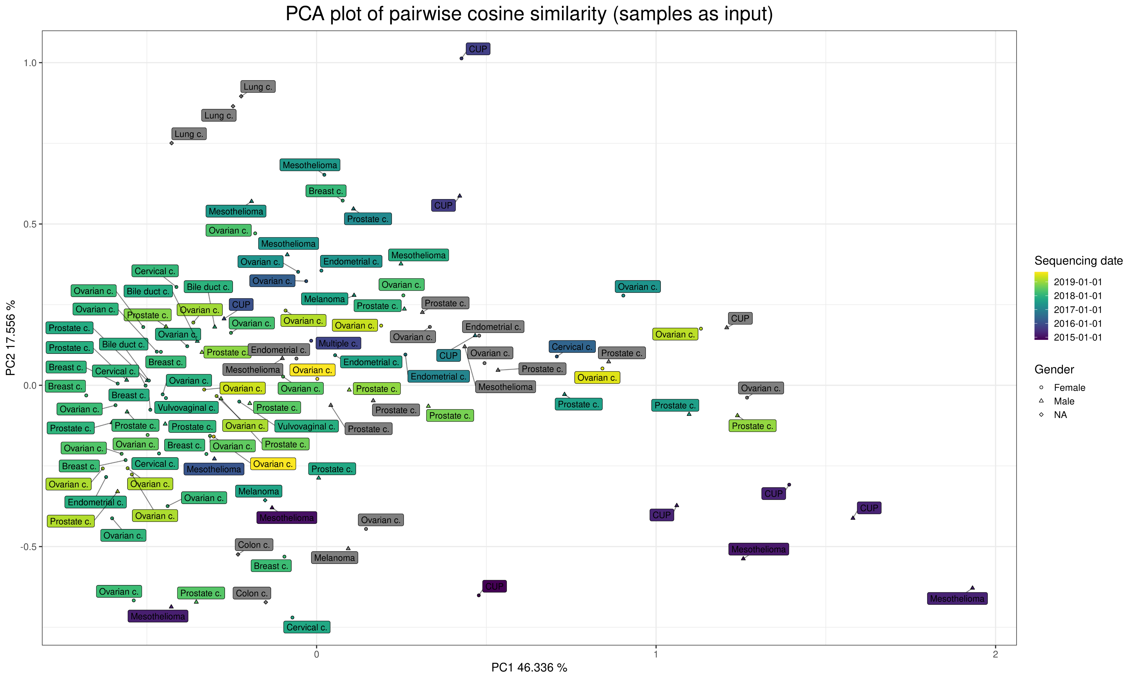

Slide 20
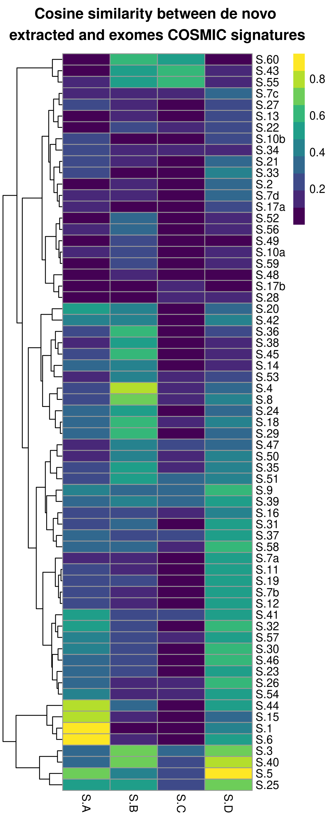
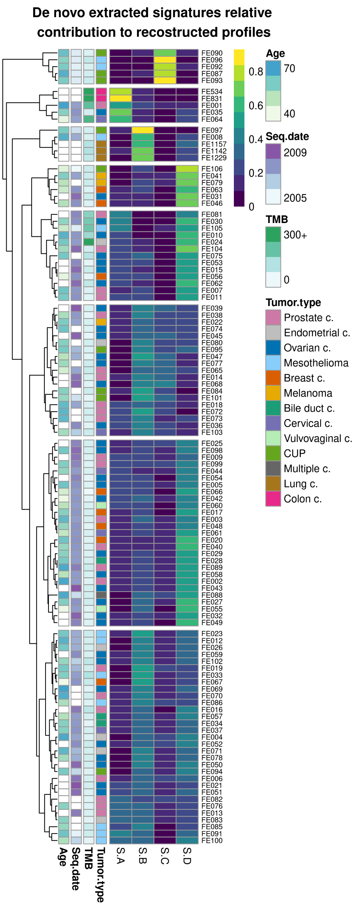
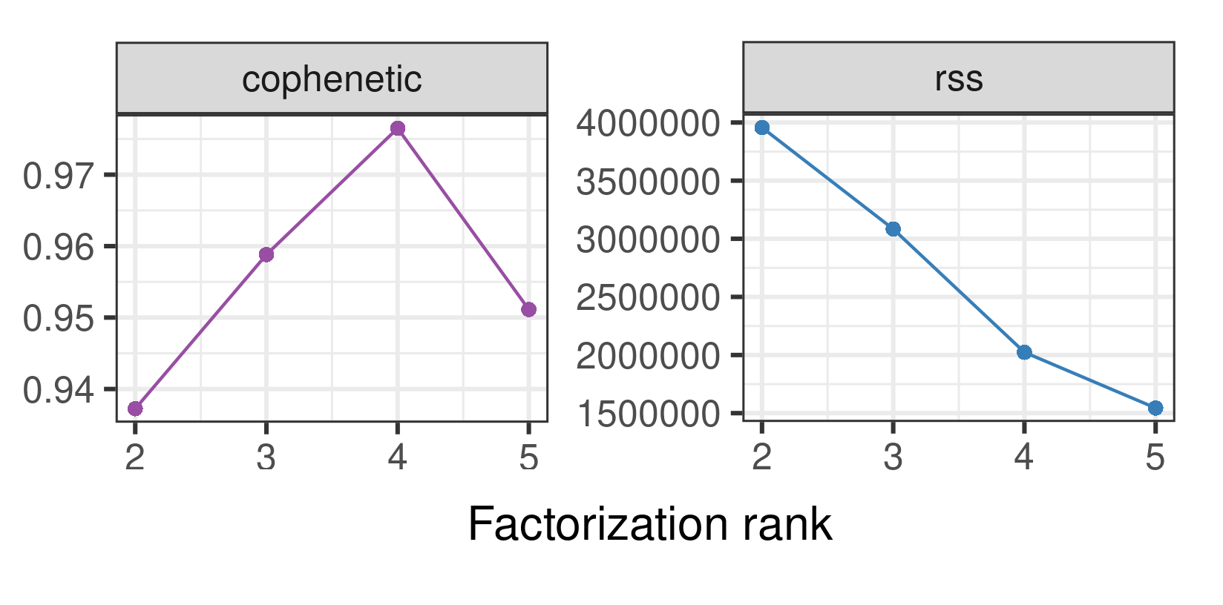
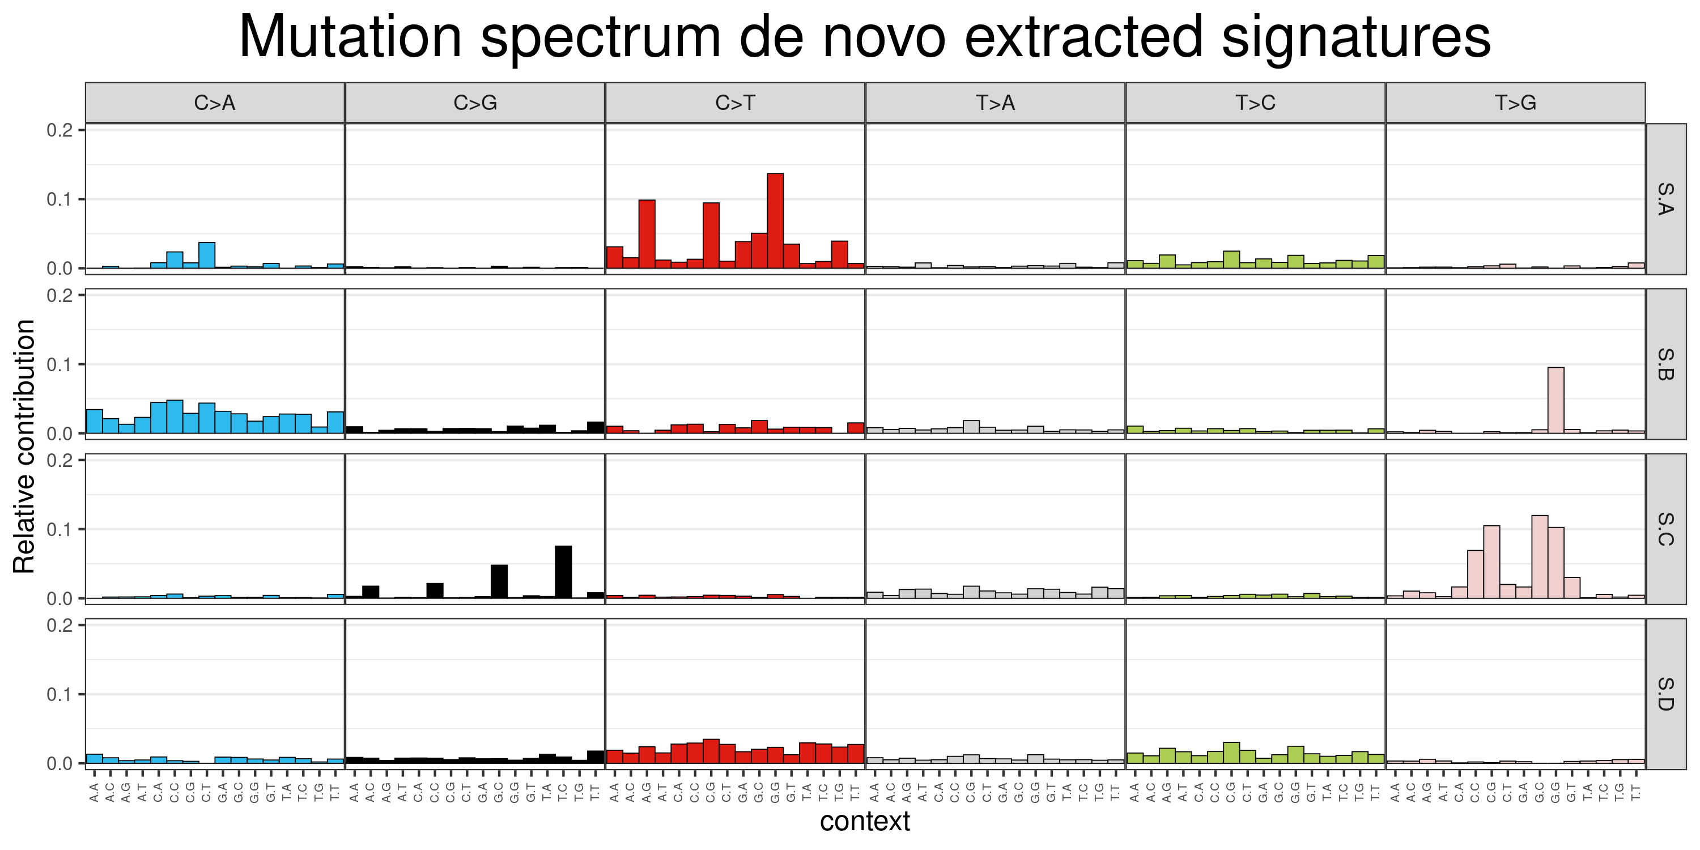
De novo extraction
Rank Estimation

Slide 21
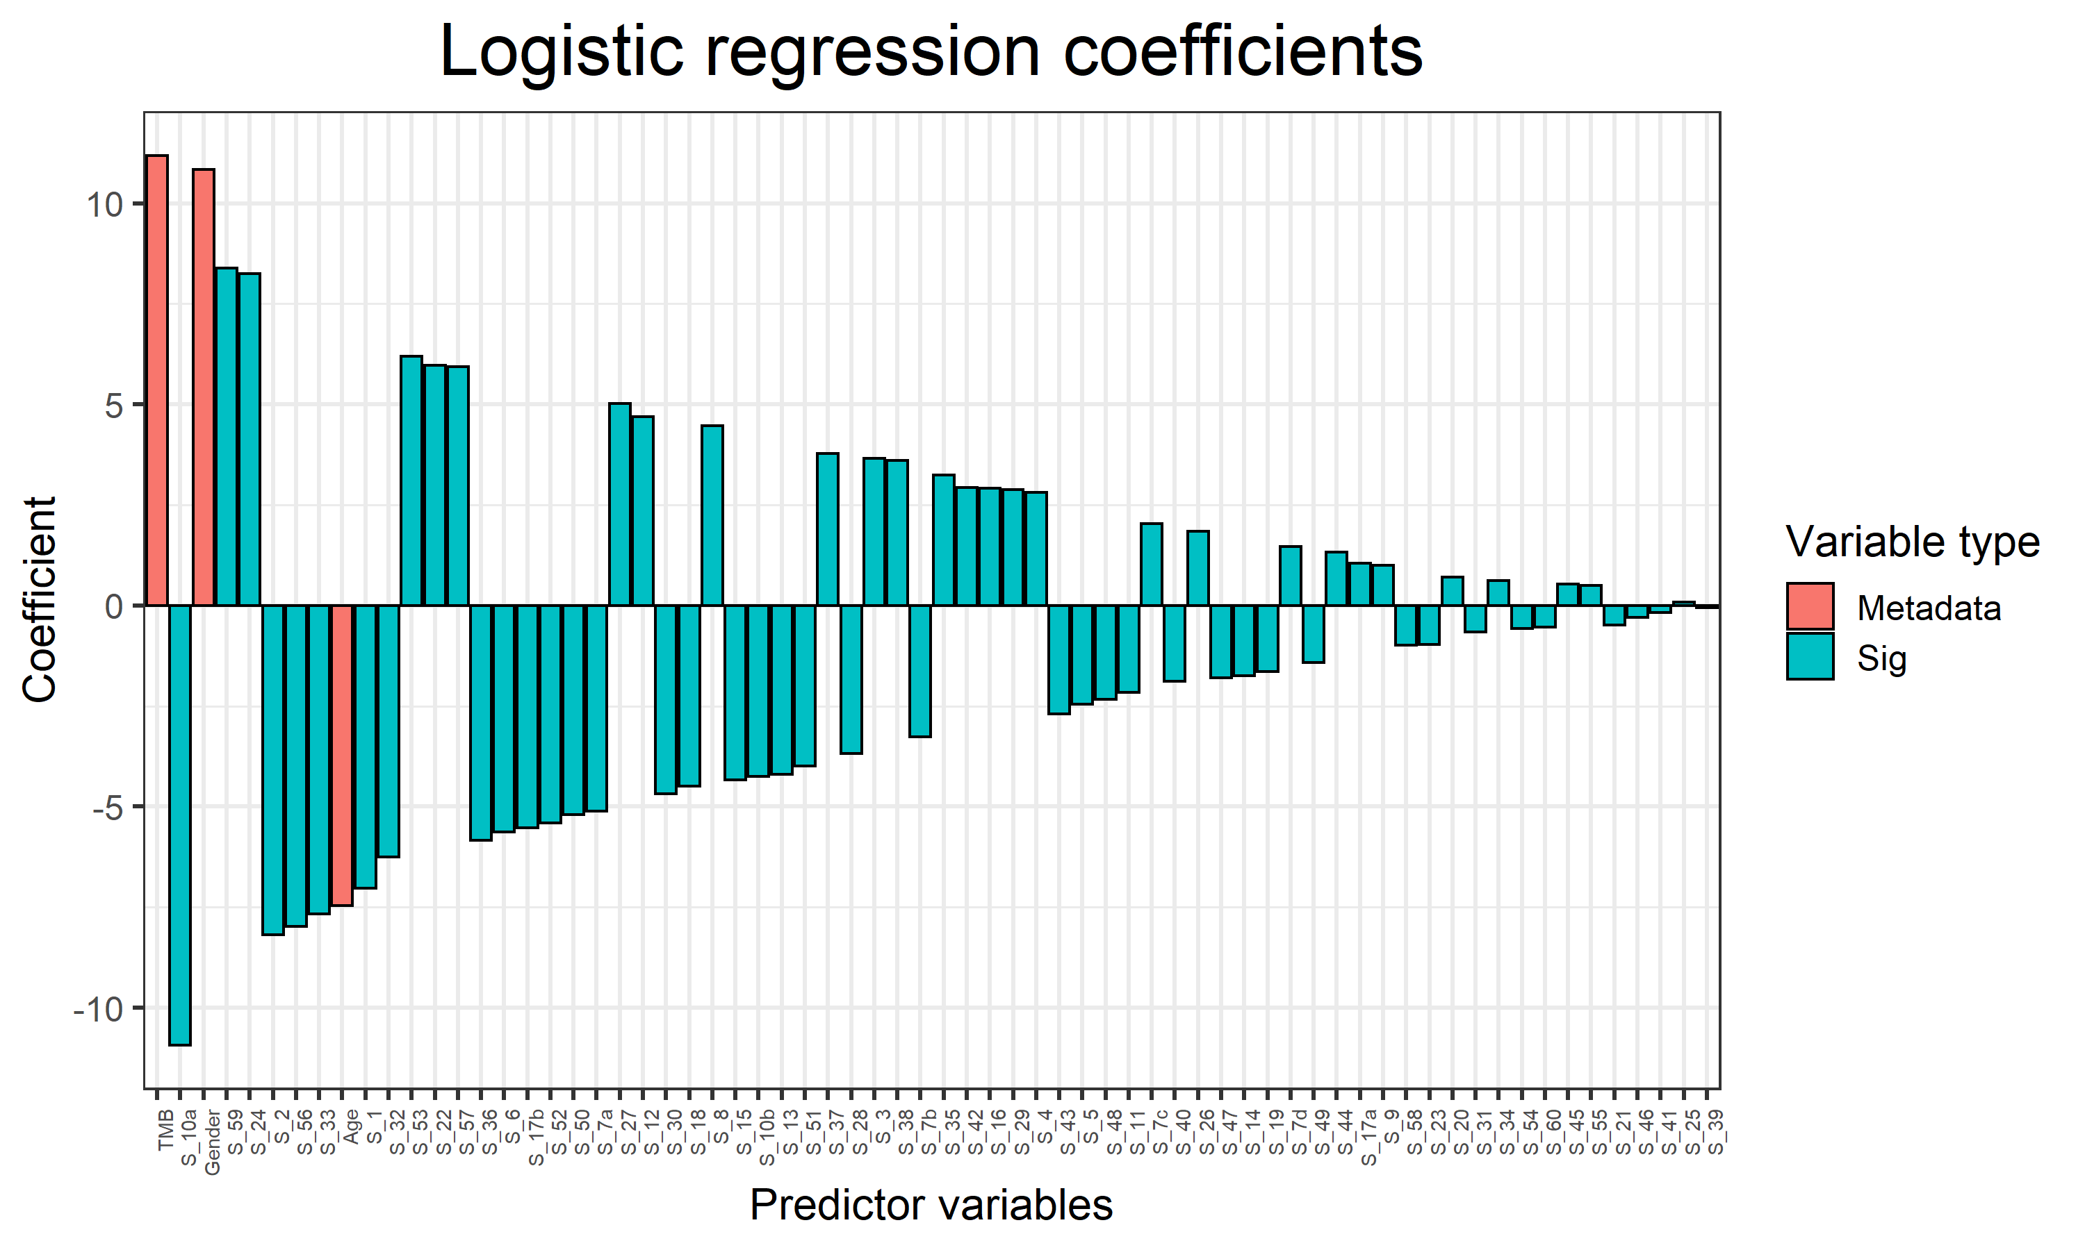

Slide 22
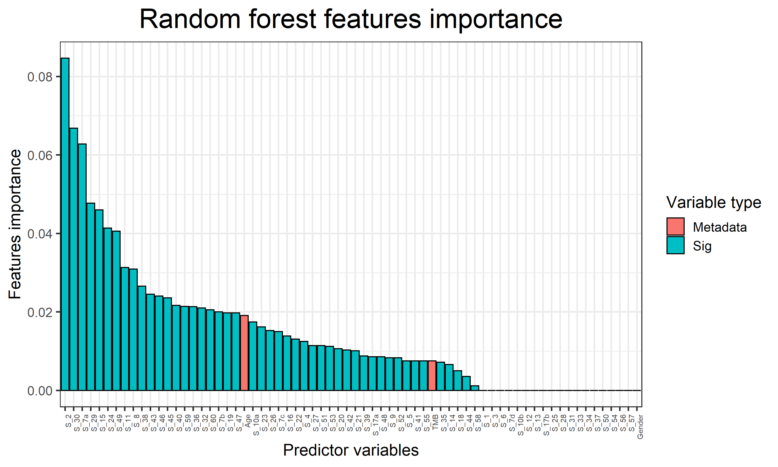

Slide 23
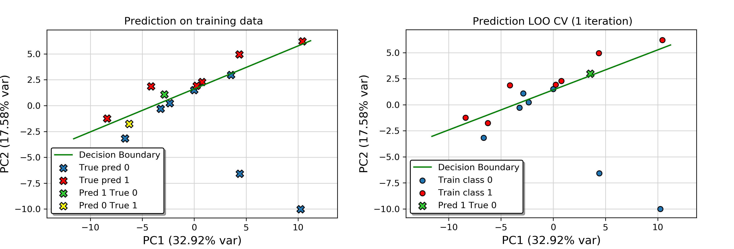
Logistic regression prediction

